Slide 1
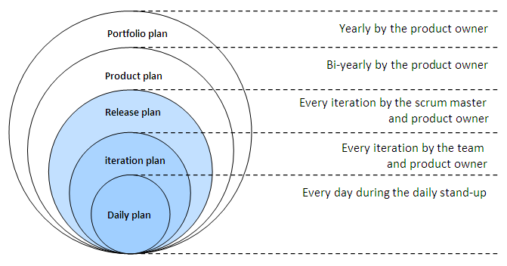

Planning – Agile Style
Highsmith, Ch 7
CSSE579
Session 3
Part 1
All kinds of iterations!
Notes:
Picture is the Agile Onion, from http://johandecoster.wordpress.com/category/estimating-and-planning/

Slide 2
Week 3’s plan
How was Exam 1? - Feedback
Our strategy – Start with “What does the PM do about planning?” Then fill-in with closely related topics.
Project planning proper:
  Slide set 1 – Agile planning – Highsmith’s view
  Slide set 2 – “Old school” planning – Phillips’ view
Project/presentation feedback from each person
Project planning – requirements (to read next):
  Slide set 3 – “Old school” requirements – Phillips’ view
  Slide set 4 - Agile requirements – Highsmith’s view
Next week’s 2nd topic – Estimation (more planning!)
Next week – Jared Goulding coming along from Rose-Hulman.
  And, it’s Good Friday / Passover

Slide 3
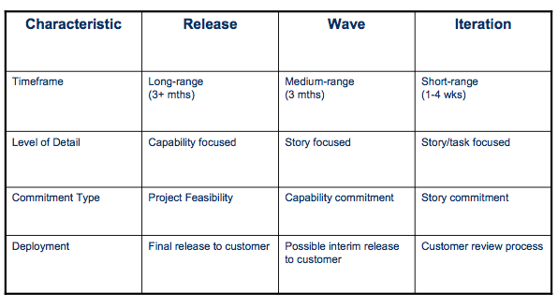
An overall view of agile planning
Notes:
From Highsmith’s presentation at http://agile2009.agilealliance.org/files/session_pdfs/Agile_2009_Release_Planning_Handouts.pdf, Slides 13 – 15. (Works fine on Firefox, if not Safari.)

Slide 4
Agile planning (for 1 release)
Starts with “Iteration 0” – 1 to 6 weeks
Assume you have the following already:
  A start on requirements – vision, elevator statement, etc. (We’ll get back to these).
  A feasibility study.
  A basic architecture to use for the project. (We’ll get back to design.)
Do some project planning – not too much.
  Revolves around creating the “user stories.”
  Team / technology initiation.
Don’t deliver useful components.

Slide 5

Highsmith calls planning “speculating”!
Are you still “on plan”?
No?
Then it must be because…
  You did something wrong that has to be remedied. And it was not good that it happened. Or,
  We tried to plan, but “this” is how it turned out. “Stuff” happened.
→
Notes:
APM, p 129
Image from http://az14597.vo.msecnd.net/public/MontyFuse4/speculating/d02e2132-f9e1-4ea0-9930-5a97e2efbeaf.htm

Slide 6
Creating the “user stories”
These expand the “Product vision” in detail.
Need to build a “Product backlog” of known stories.
  Client will choose from these for each iteration.
  By priority – at least consider the greatest value first!
  But probably done with our help (e.g., what’s technically doable first).

Slide 7
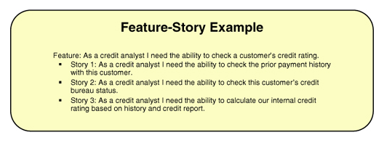
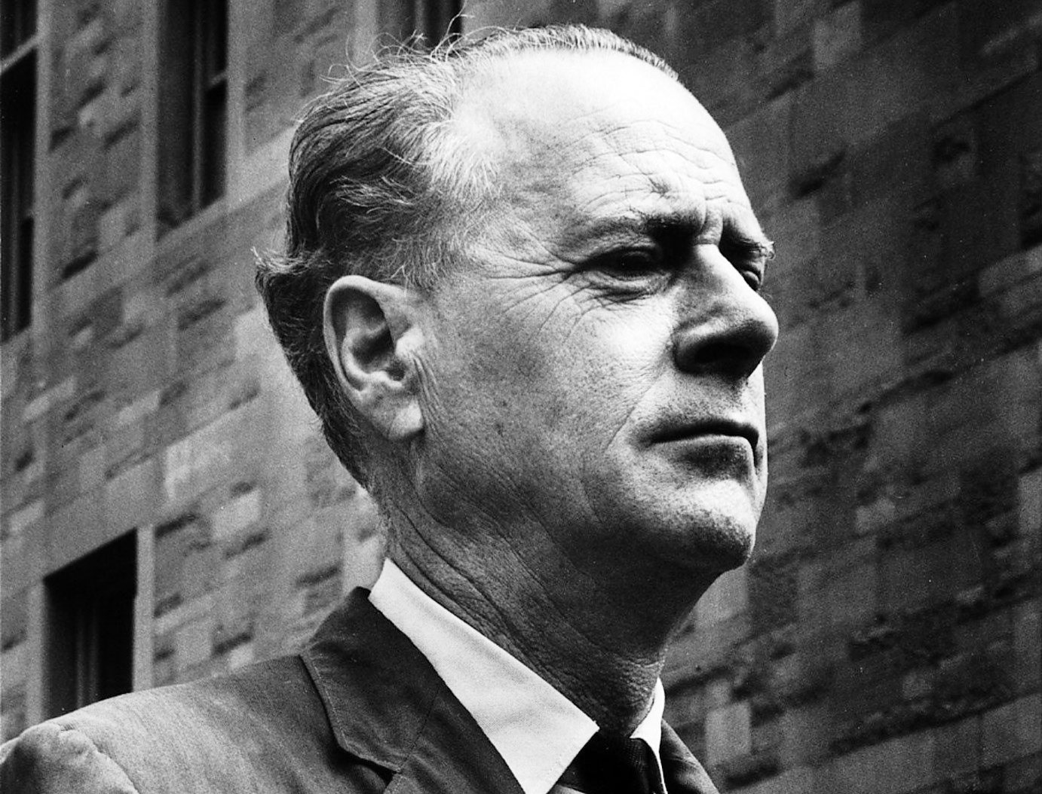
Review –
What’s a user story look like?
“The medium is the message.”
- McLuhan
Notes:
Marshall McLuhan image from http://www.periodicoenfoque.com.mx/2012/07/influyo-mcluhan-en-la-cultura-de-la-segunda-mitad-del-siglo-xx/

Slide 8
User story variations
Story 1 enhanced:
As a credit analyst,
I want the ability to check the prior payment history
With this customer
So that I can decide to grant a loan.
Who
What
When / Where
Why
→

Slide 9
Short group activity – User stories
Do you do user stories now?
Do they look like the ones we’ve discussed?
If you don’t do them, what would it add?
And what could you take away if you did them?

Slide 10
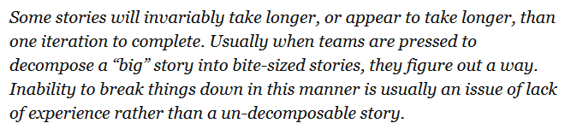
How about big, messy stories?
How about technical stories?
“A script will migrate the old database to the new system.”
→
Notes:
APM, p 196

Slide 11

How about things we discover they need?
“In planning a product, however, some items that need to be delivered may not sound – at least to customers or product managers – as though they provide direct benefit.”
Client wants children to be main users
For safety, they’ll all need to have short hair
To guarantee that, our system better provide the haircuts!
Notes:
Haircut image courtesy of http://library.austintexas.gov/archive/201211.

Slide 12
Features are made up of stories
Marketing has to sell the product in larger “chunks” than stories.
In our combination of technical / customer value thinking, it makes sense to:
  Deal with features at a level of granularity where we can picture what we’d do, and how long it will take.
  While still being able to “roll-up” how these stories must fit into the whole feature & system.
Notes:
APM, pp 134-5

Slide 13
Who writes these stories?
Customer?
Business analyst sitting with customer? See next slide. →
Developers sitting with customer?
Big meeting like JAD?
  (See SPMH p 113)
Trickle-down from systems engineering work?

Slide 14
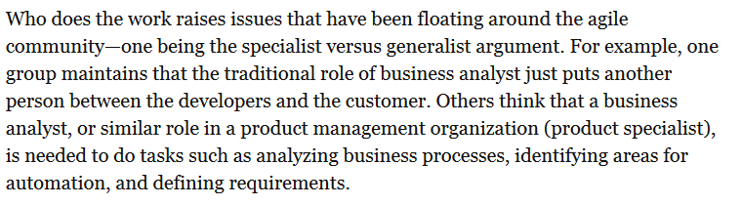
Remember the Business Analyst?
Notes:
APM, p 140

Slide 15
Stories go on cards
“As a sales associate, the ability to calculate the total amount of the sale, so that I can negotiate payment with the customer.”
  Probably includes things for multiple people to develop at several layers of software.
  Quantify customer value and estimated “points” to do it.
  And perceived risks!
  Can add all these annotations. (See APM p 139.)
  Putting them on cards or PostIts makes them Mobile.
  Could be used with “Parking Lot” (p 148), or Kanban, for example. →
  Big projects – need to automate all this!
Notes:
See Wikipedia for an intro to Kanban!

Slide 16
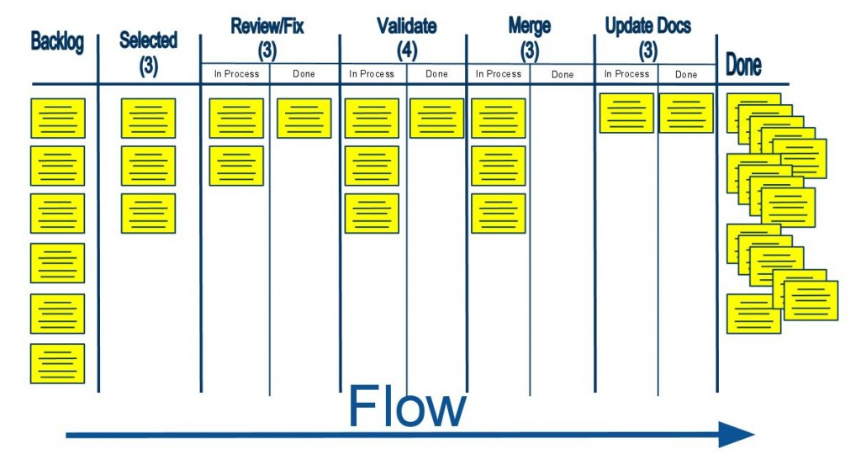
Kanban at work…
We’re still here!
→
Notes:
From http://www.mcpa.biz/2014/02/using-scrum-kanban-safe-dsdm-dad/

Slide 17
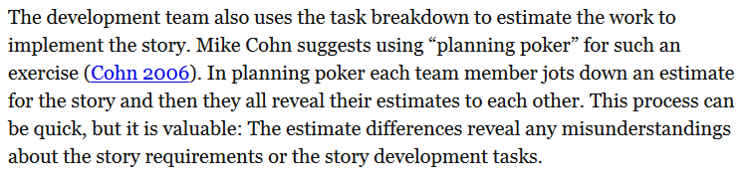
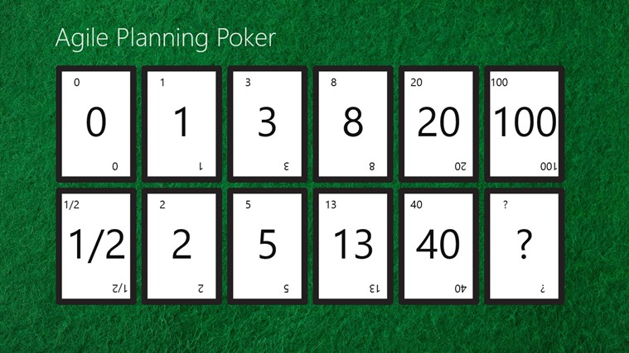
Remember planning poker?
Notes:
APM, p 139
Typical planning poker cards from http://apps.microsoft.com/windows/en-us/app/agile-planning-poker/fd84a52b-d0ce-478f-97e7-a82021a8fa6a

Slide 18
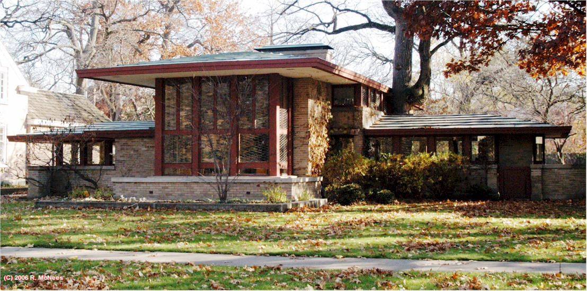
Go for simplicity at all times!
The art of maximizing the amount of work not done.
Always in vogue? – Minimalist architecture.
Notes:
See APM p 146.
Image of Frank Lloyd Wright’s 1908 Isabel Roberts house in River Forest, IL, from https://www.pinterest.com/timbailey859/frank-lloyd-wright/

Slide 19
How iterations simplify planning
In 3 main ways?
Flexibility – change when you discover issues
  Know where problems are before committing
It’s easier than up-front planning
Feedback to customer
  Lets them change their mind
But – need to avoid “looming technical risk”
  Dodging “technical debt” – like building the DB
→

Slide 20
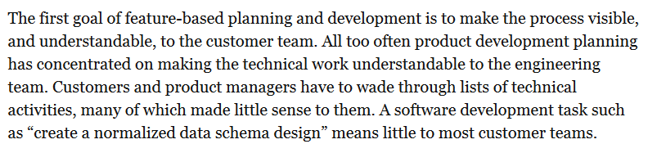
Visibility of iterations…
Difficult to explain to the customer:
Developer Skills
Technologies
Integration
Notes:
APM p 130

Slide 21
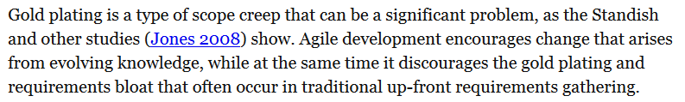
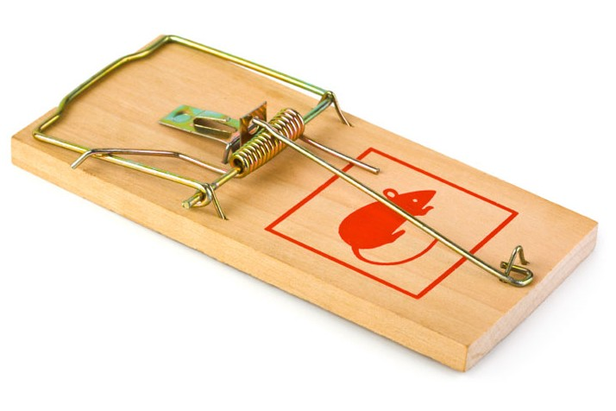
High quality ≠ More elaborate
Notes:
APM, p 145
Unimproved mousetrap from http://cottagelife.com/13796/diy/tools-products/choosing-a-mousetrap

Slide 22
Iteration 0
Anticipation vs adaptation
  More uncertainty and complexity →
  more adaptation
  See Highsmith’s presentation at http://agile2009.agilealliance.org/files/session_pdfs/Agile_2009_Release_Planning_Handouts.pdf, Slides 13 – 15. (Works fine on Firefox, if not Safari.)
  This anticipates his Ch 8 – Multiple releases.
→

Slide 23
Your questions from the reading quiz
My pick
Your choice

